Slide 1
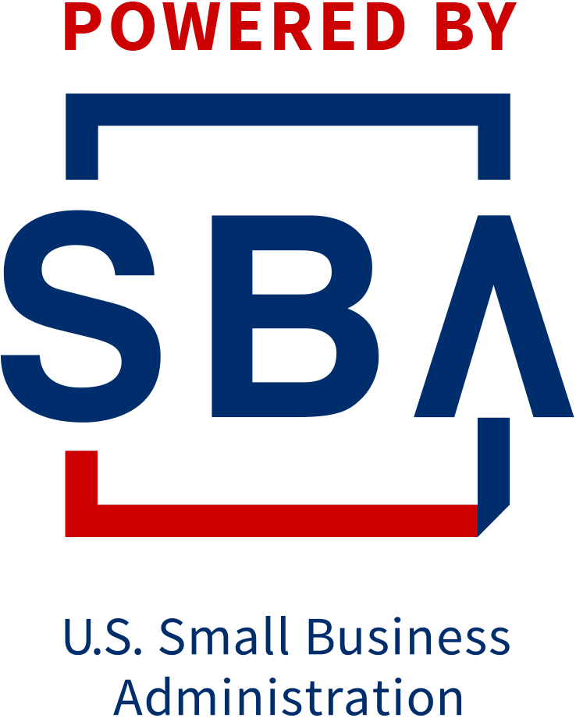
Legal Foundations Every Florida Business Owner Should Know
Presented by: Matthew Fornaro

Slide 2
Agenda
About SCORE
Speaker Introduction
Webinar
Questions
Short Poll
Closing Remarks

Slide 3

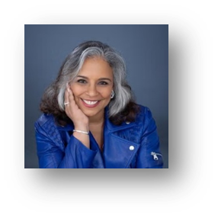





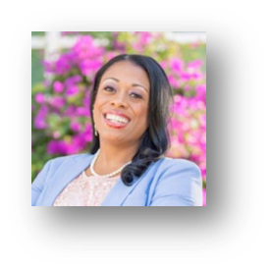
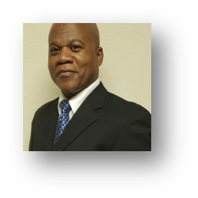
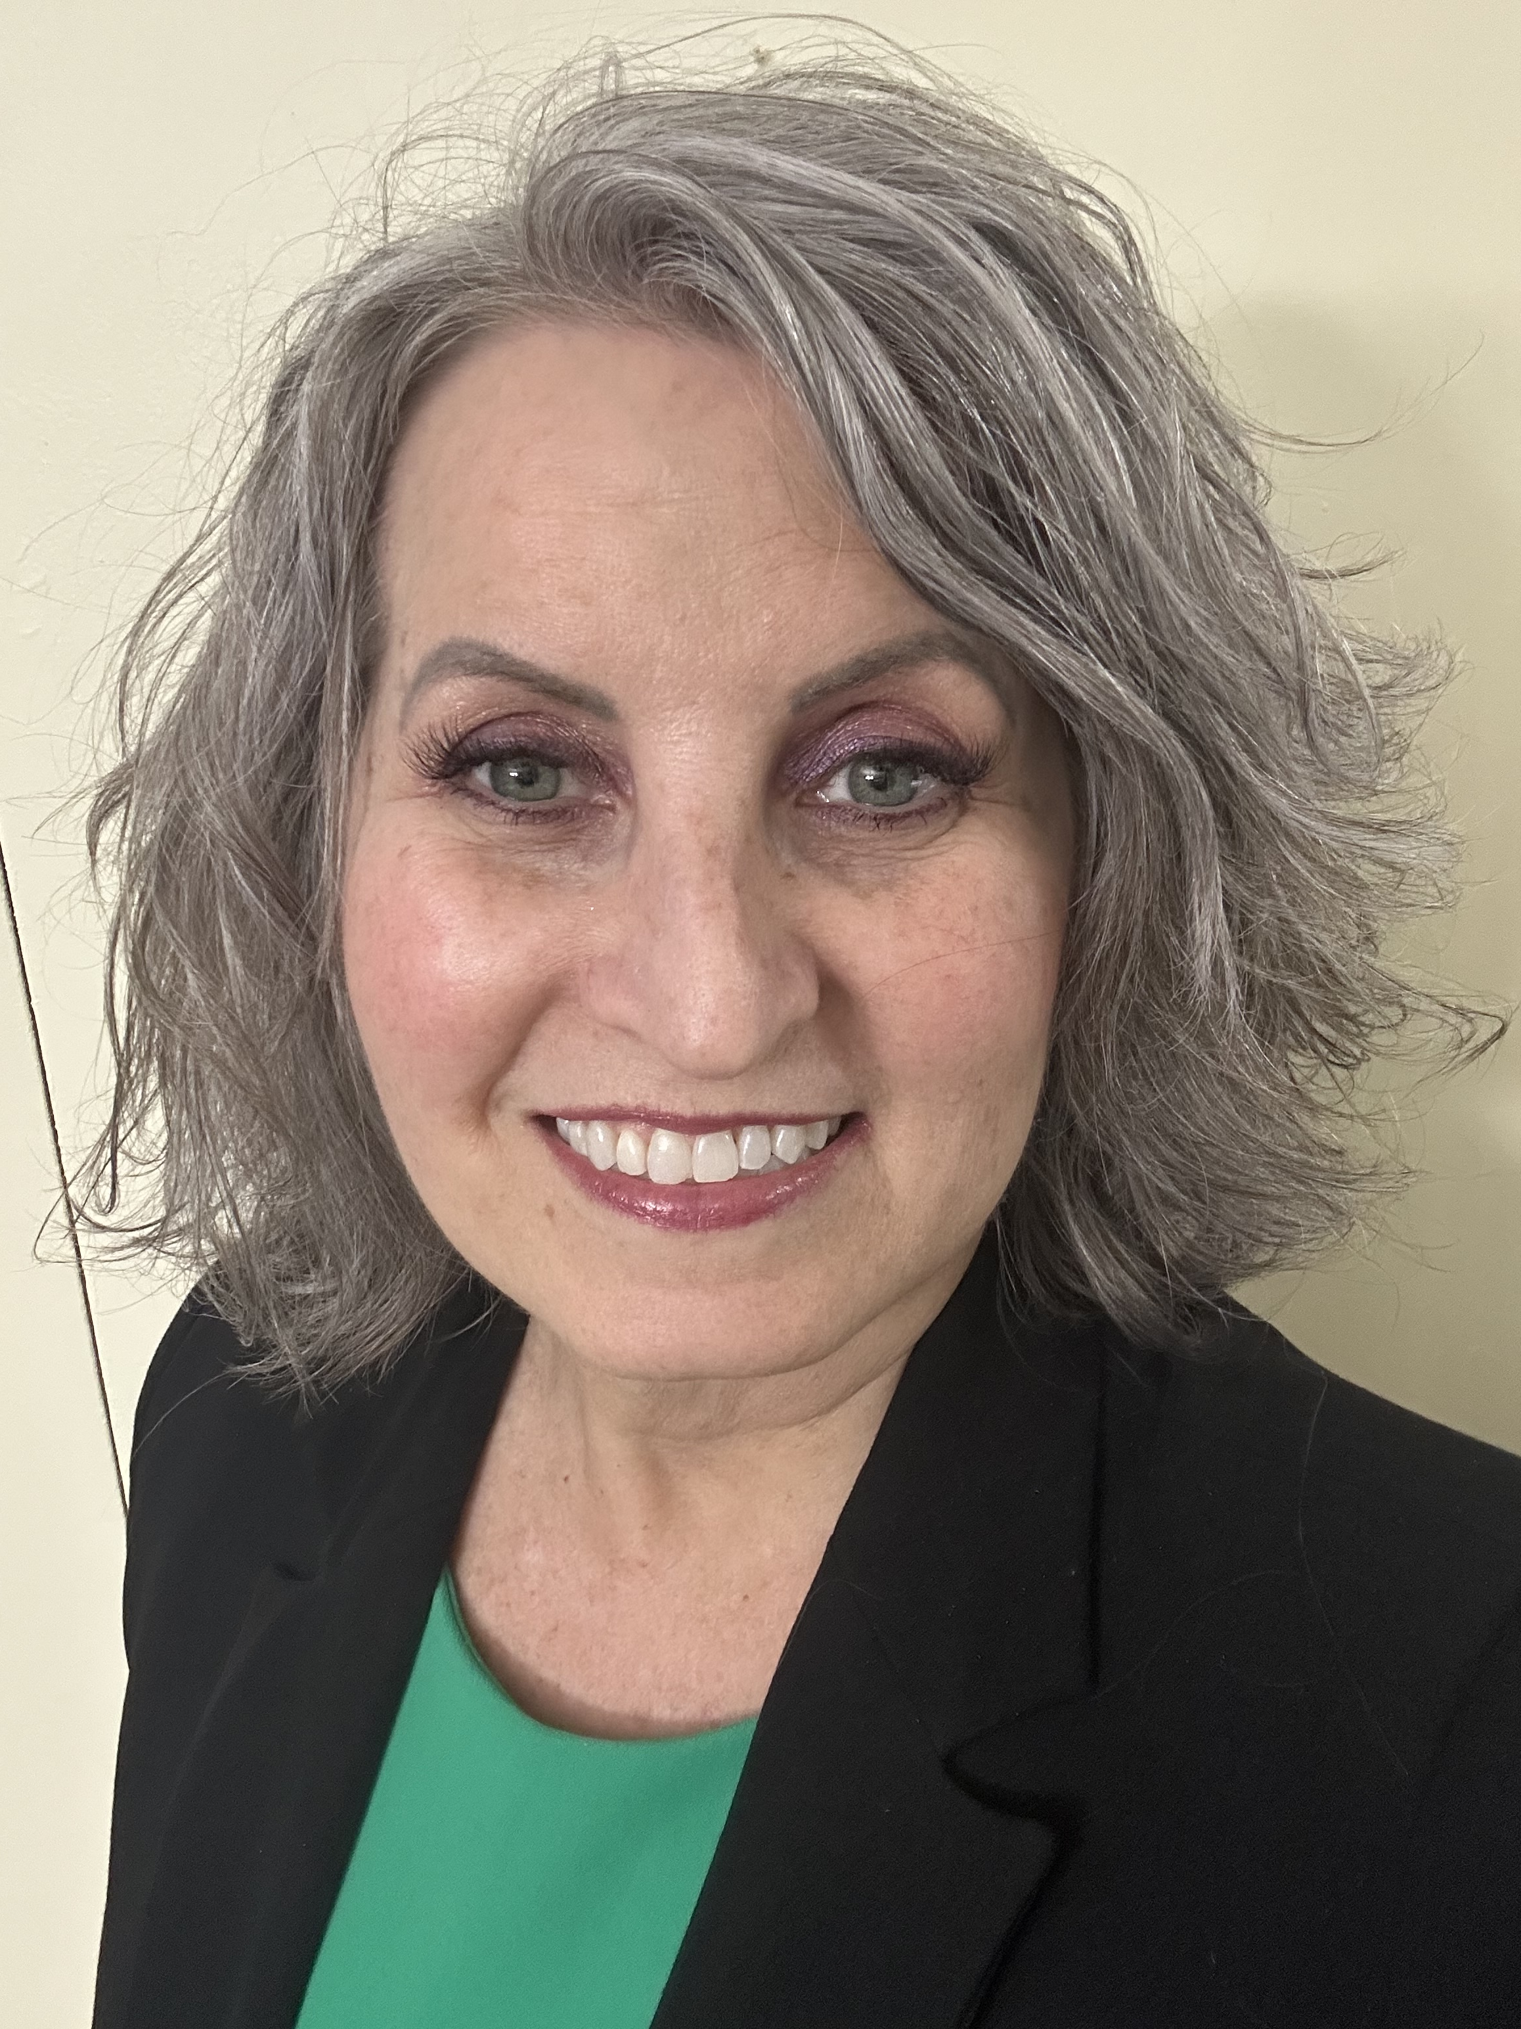
Who we are - SCORE Broward
Nonprofit. Established in 1964
Cadre of 80 volunteers
3,000 one-on-one mentoring sessions/yr.
Over 15,000 South Florida entrepreneurs/yr. attend our webinars/workshops/events

Slide 4

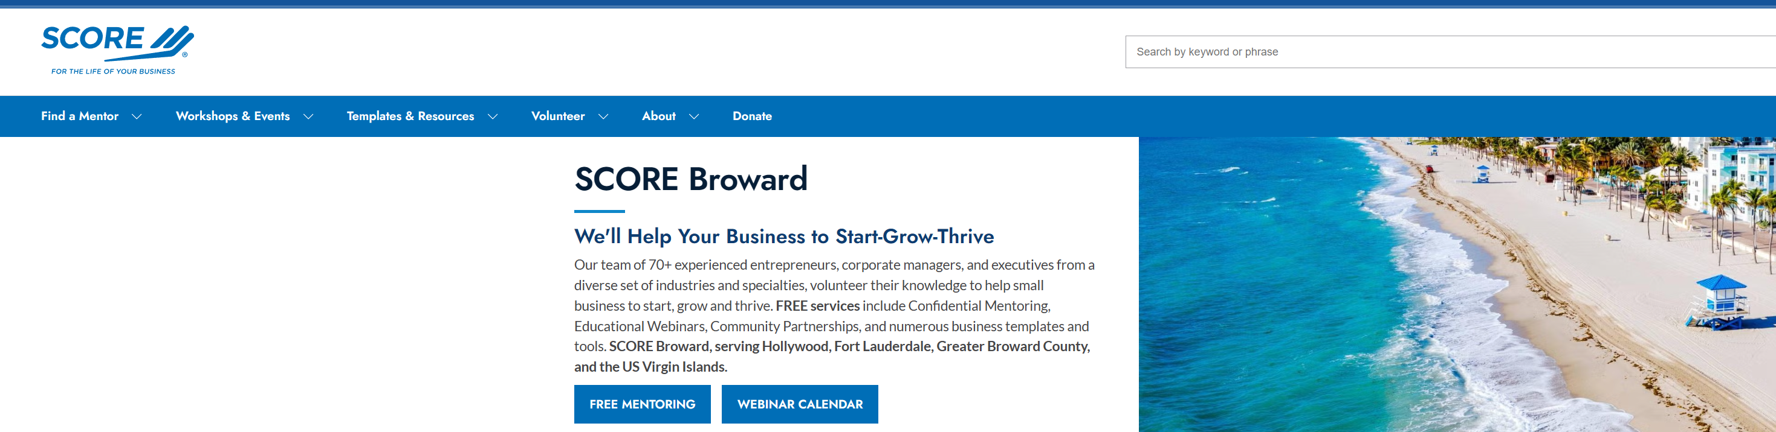
Webinars
150 business topics
Over 300 live webinars a year
Mon./Tue./Wed/Thu. Evenings
Saturday mornings in Spanish
Some middays
Go to www.broward.score.org

Slide 5
Webinar/Workshop Guidelines
This webinar is being recorded
Upon completion you will receive an email with:
  The url to a recording of this webinar
  Any supporting documents referred to during the presentation
  A link to donate to our chapter 017 SCORE BROWARD
  A link to your free mentoring sessions. Mentor Request Form
  A link to our google review page. Please leave a favorable review.
Ask questions as we go along using the “Q&A” button on your screen

Slide 6

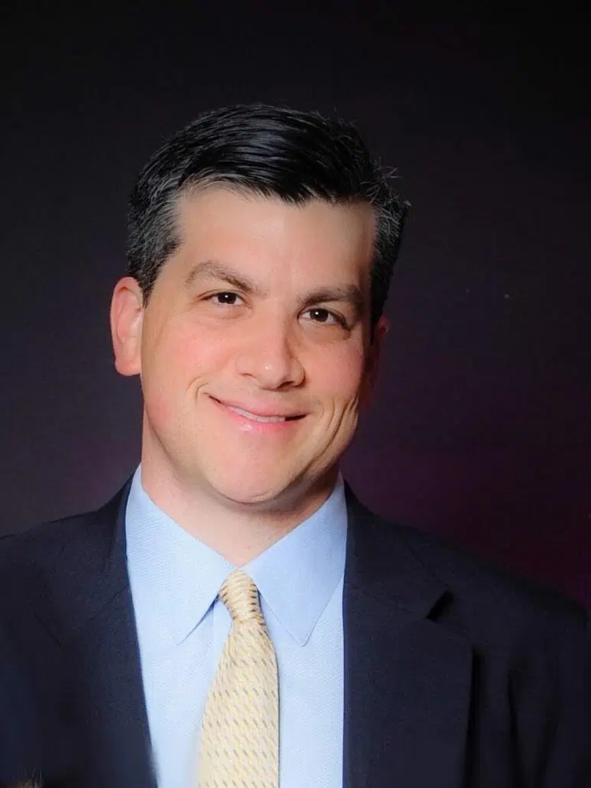
Legal Foundations Every Florida Business Owner Should Know
A practical SCORE webinar for entrepreneurs, startups, and growing companies
Matthew Fornaro, Esquire
Matthew Fornaro, P.A.
Coral Springs, Florida
Educational information only. Not legal advice.
Educational information only | Not legal advice | Matthew Fornaro, P.A.
1
Notes:
Opening: welcome attendees, thank SCORE Broward, and establish the session as educational rather than legal advice. Explain that examples are simplified and that business owners should seek advice for specific facts. Approx. 2 minutes.

Slide 7

Why this session matters
Most legal problems begin as ordinary business decisions.
A handshake deal becomes a collections dispute.
A founder disagreement becomes a control issue.
A copied logo or unclear contractor agreement becomes an ownership problem.
A vendor relationship breaks down because the written terms are incomplete.
The objective is not to make business owners fearful. It is to help them make better decisions earlier.
Educational information only | Not legal advice | Matthew Fornaro, P.A.
2
Notes:
Frame the session as practical risk management. Emphasize that legal planning is a business tool, not an obstacle. Approx. 3 minutes.

Slide 8

Learning objectives
By the end of the webinar, attendees should be able to spot the legal issues that most often hurt Florida businesses.
Choose an entity structure with more informed questions.
Identify the core documents every business should keep in writing.
Recognize common contract gaps before they become disputes.
Understand basic IP ownership and brand protection issues.
Know when to escalate a dispute, and how to preserve leverage.
Educational information only | Not legal advice | Matthew Fornaro, P.A.
3
Notes:
Preview the value of the program. This is a 75-minute session with practical takeaways and a closing action plan. Approx. 2 minutes.

Slide 9
75-minute roadmap
Suggested timing for a live SCORE webinar.
✓
0-5 min: welcome and disclaimers
✓
30-47 min: contracts that reduce disputes
✓
66-72 min: dispute resolution and litigation readiness
✓
5-18 min: entity and startup basics
✓
47-58 min: IP and ownership issues
✓
72-75+ min: action plan, resources, and Q&A
✓
18-30 min: governance and records
✓
58-66 min: employees, contractors, and restrictive covenants
Educational information only | Not legal advice | Matthew Fornaro, P.A.
4
Notes:
Explain that the presentation is designed for at least 75 minutes and can be expanded through Q&A and examples. Approx. 1 minute.

Slide 10

First principle: legal risk follows business growth
The more relationships the business has, the more important clarity becomes.
Owners and co-founders: control, money, exit, deadlock.
Customers and clients: scope, payment, refunds, complaints.
Vendors and suppliers: delivery, quality, warranties, termination.
Employees and contractors: classification, confidentiality, ownership.
Brand and technology: name, content, data, AI, accounts.
Educational information only | Not legal advice | Matthew Fornaro, P.A.
5
Notes:
Use this slide to explain that legal planning is relationship management. Each relationship needs rules, records, and remedies. Approx. 3 minutes.

Slide 11

1. Entity choice and Florida startup basics
What you form affects taxes, governance, liability, credibility, and future disputes.
Florida business owner legal foundations
6
Notes:
Section transition. Approx. 30 seconds.

Slide 12
Entity options: what business owners usually compare
This is not tax advice. Tax election and entity structure should be coordinated with a CPA.
Common options
Business questions
Sole proprietorship
General partnership
Limited liability company
Corporation: S-corp or C-corp tax treatment
Professional entities where applicable
Who owns the business?
Who controls decisions?
Will there be investors?
Will owners work in the business?
What happens if someone exits?
Educational information only | Not legal advice | Matthew Fornaro, P.A.
7
Notes:
Compare the practical business questions rather than giving a tax lecture. Explain that liability protection can be weakened by poor records or personal guarantees. Approx. 5 minutes.

Slide 13

Why many Florida small businesses choose LLCs
LLCs are flexible, but flexibility is not a substitute for written rules.
Useful for single-owner and multi-owner businesses.
Can be member-managed or manager-managed.
The operating agreement should answer governance, money, transfer, and exit issues.
Even single-member LLCs should keep separate finances and records.
Banks, landlords, vendors, and investors often care about documentation.
Educational information only | Not legal advice | Matthew Fornaro, P.A.
Fla. Stat. Ch. 605
8
Notes:
Tie LLC flexibility to operating agreements. Mention that an LLC is bound by and may enforce its operating agreement under Florida law. Approx. 4 minutes.

Slide 14
Corporations: when the formal structure helps
Corporations can be useful where formal ownership, shares, or investor expectations matter.
Articles, bylaws, directors, officers, shareholder approvals, and minutes matter.
Bylaws set internal rules consistent with the articles and law.
S-corp tax treatment is a tax election, not a separate Florida entity type.
Corporate formalities should match how the business actually operates.
Do not form first and plan later when multiple owners are involved.
Educational information only | Not legal advice | Matthew Fornaro, P.A.
Fla. Stat. Ch. 607
9
Notes:
Discuss corporations as more formal but sometimes better for ownership structure. Approx. 3 minutes.

Slide 15
Avoid accidental partnerships and informal liability
A business relationship can create legal consequences before anyone files anything.
Risk pattern
Preventive step
Two people start selling together.
Revenue is split without written ownership terms.
One person signs vendor contracts.
No written exit or buyout plan.
The business name is used before clearance.
Define roles before launch.
Use written founder terms.
Separate entity money from personal money.
Document authority to sign.
Check name, domain, and trademark risk.
Educational information only | Not legal advice | Matthew Fornaro, P.A.
10
Notes:
Explain that the problem is not merely filing status. The problem is unclear expectations. Approx. 3 minutes.

Slide 16
Florida filing basics: Sunbiz is the start, not the finish
A filing creates a public record. It does not create a complete legal operating system.
Use Sunbiz to form and maintain Florida entities and fictitious names.
File annual reports on time to maintain active status and avoid late fees or administrative dissolution.
Update addresses, registered agent information, and manager/officer information as needed.
A fictitious name or DBA registration does not itself create trademark ownership.
Keep copies of filings, certificates, operating documents, and tax registrations.
Educational information only | Not legal advice | Matthew Fornaro, P.A.
Sunbiz / Fla. DOS
11
Notes:
Explain what Sunbiz does and does not do. The audience often confuses entity registration, DBA, tax registration, and trademark rights. Approx. 4 minutes.

Slide 17
Federal and tax startup basics
Coordinate legal formation with accounting and tax setup.
Apply for an EIN directly through the IRS. It is free through the IRS.
Register with the Florida Department of Revenue when your activities require it.
Sales tax, corporate income tax, reemployment tax, and new-hire reporting may apply depending on the business.
Domestic U.S. entities are currently exempt from BOI reporting to FinCEN under the 2025 interim final rule, but owners should monitor changes.
Separate legal, tax, licensing, and insurance workstreams.
Educational information only | Not legal advice | Matthew Fornaro, P.A.
IRS / Fla. DOR / FinCEN
12
Notes:
Be careful on BOI because it changed. State the current rule and advise monitoring official FinCEN guidance. Approx. 4 minutes.

Slide 18

2. Governance: the documents that prevent owner disputes
Written governance answers uncomfortable questions before money, stress, or mistrust makes them harder.
Florida business owner legal foundations
13
Notes:
Section transition. Approx. 30 seconds.

Slide 19
Operating agreements and bylaws: the owner playbook
The core question: who can do what, with whose approval, and what happens next?
Ownership percentages and capital contributions.
Management authority and reserved major decisions.
Profit distributions, tax allocations, and reinvestment expectations.
Transfer restrictions, buy-sell rights, death, disability, and divorce issues.
Deadlock procedures and dispute resolution provisions.
Educational information only | Not legal advice | Matthew Fornaro, P.A.
Fla. Stat. §§ 605.0106, 607.0206
14
Notes:
Give examples: one owner wants to borrow money; one owner wants to leave; one owner stops working. Approx. 4 minutes.

Slide 20
Multi-owner businesses: plan for the fight you hope never happens
Most owner disputes are predictable.
Common triggers
Written solutions
Different work levels.
Unequal cash contributions.
No salary or distribution policy.
Personal expenses charged to the business.
One owner controls books or banking.
Defined duties and time commitments.
Capital call rules.
Distribution policy.
Expense approval rules.
Accounting access and reporting cadence.
Educational information only | Not legal advice | Matthew Fornaro, P.A.
15
Notes:
Use plain examples to explain why vague trust is not a governance system. Approx. 4 minutes.

Slide 21
Business records that make disputes easier to solve
Good records are inexpensive insurance.
✓
Filed articles and amendments
✓
Bank authority records
✓
Licenses and local tax receipts
✓
Operating agreement or bylaws
✓
Major contracts and renewals
✓
IP assignments and brand records
✓
Minutes or written consents
✓
Tax registrations and filings
✓
Employee and contractor agreements
✓
Cap table or ownership ledger
✓
Insurance policies
✓
Important emails and notices
Educational information only | Not legal advice | Matthew Fornaro, P.A.
16
Notes:
Walk through the checklist. Explain that litigation often turns on records created before anyone thought there would be litigation. Approx. 3 minutes.

Slide 22
Authority to sign: who can bind the business?
A business owner should know who can sign what before there is a problem.
Internal approval rules do not always protect the business from third-party claims.
Limit signing authority by role, amount, and contract type.
Use board/member approvals for major transactions.
Keep vendor-facing signature blocks consistent with the entity name.
Avoid personal guarantees unless the risk is understood and accepted.
Educational information only | Not legal advice | Matthew Fornaro, P.A.
17
Notes:
Discuss personal guarantees with leases, credit applications, merchant agreements, vendor financing, and SBA loans. Approx. 3 minutes.

Slide 23

3. Contracts that protect the business relationship
A good contract is not just paper. It is a decision tool for when expectations diverge.
Florida business owner legal foundations
18
Notes:
Section transition. Approx. 30 seconds.

Slide 24
Why form contracts fail
Templates are helpful only when the business understands the deal.
The contract does not match the actual transaction.
Payment timing, milestones, and acceptance standards are vague.
No termination rights or cure period.
No limitation of liability, warranty limits, or dispute clause.
The parties sign as individuals rather than the correct entity.
Educational information only | Not legal advice | Matthew Fornaro, P.A.
19
Notes:
Explain that online forms are starting points, not business-specific risk assessments. Approx. 4 minutes.

Slide 25
Seven terms every business contract should answer
If the contract cannot answer these questions, neither can the business.
✓
Who are the parties?
✓
What happens if performance is late or defective?
✓
Are fees and costs recoverable?
✓
What exactly is being provided?
✓
How can the agreement end?
✓
Who owns work product or data?
✓
When is performance due?
✓
How will disputes be handled?
✓
What confidentiality duties apply?
✓
How and when is payment due?
✓
Which law and venue apply?
✓
What remedies are excluded or limited?
Educational information only | Not legal advice | Matthew Fornaro, P.A.
20
Notes:
Use this as an interactive section. Ask attendees to compare this list against their customer, vendor, and lease documents. Approx. 5 minutes.

Slide 26
Payment and collections: build leverage before default
Most collection disputes are contract-design problems.
Before the deal
After nonpayment
Deposit or retainer language.
Milestone invoicing.
Clear acceptance process.
Late fees and interest where lawful.
Suspension rights for nonpayment.
Preserve invoices and communications.
Do not keep performing indefinitely.
Send clear written notice.
Evaluate settlement before litigation.
Track recoverable fees and costs.
Educational information only | Not legal advice | Matthew Fornaro, P.A.
21
Notes:
Discuss practical collections in Florida without giving debt collection legal advice. Emphasize leverage, documentation, and timing. Approx. 4 minutes.

Slide 27
Commercial leases, vendors, and customer agreements
Different contracts protect different risks.
Commercial lease: use, exclusivity, build-out, defaults, personal guarantee, assignment, renewal, relocation, operating expenses.
Vendor agreement: scope, delivery, quality, indemnity, insurance, termination, supply interruptions.
Customer terms: refunds, chargebacks, service limitations, warranties, limitation of liability, dispute process.
Strategic point: negotiate the few terms that could actually hurt the business.
Educational information only | Not legal advice | Matthew Fornaro, P.A.
22
Notes:
Give examples from small businesses: restaurant lease, service business master terms, construction or specialty vendor. Approx. 4 minutes.

Slide 28
E-signatures and document hygiene
The problem is usually not whether signing electronically is allowed. It is whether the final deal can be proven.
Keep complete final PDFs, not only signature pages.
Preserve version history for negotiated agreements.
Use consistent entity names and titles.
Store signed contracts in a searchable system.
Calendar renewal, notice, insurance, and termination dates.
Educational information only | Not legal advice | Matthew Fornaro, P.A.
23
Notes:
This is a practical operations slide. Emphasize that contract management is a business process. Approx. 3 minutes.

Slide 29

4. Intellectual property and ownership basics
The business should know what it owns, what it licenses, and what it is only borrowing.
Florida business owner legal foundations
24
Notes:
Section transition. Approx. 30 seconds.

Slide 30
IP map for small business owners
Different rights protect different assets.
Asset type
Likely issue
Brand name and logo
Website copy and creative content
Software, code, design, product assets
Confidential customer lists and processes
Inventions and product functionality
Trademark clearance and registration
Copyright ownership and licenses
Work-made-for-hire or assignment language
Confidentiality and trade secret protection
Patent analysis when appropriate
Educational information only | Not legal advice | Matthew Fornaro, P.A.
USPTO / Copyright Office
25
Notes:
Explain that IP protection starts with knowing what asset is at issue. Approx. 4 minutes.

Slide 31

Trademarks: choosing a name before investing in it
A business name, domain, Sunbiz filing, and trademark are related but not the same.
Search before spending heavily on branding.
Distinctive names are stronger than descriptive names.
A Florida entity filing does not guarantee federal trademark rights.
Using another business’s confusingly similar name can create expensive rebranding and dispute risk.
Registration strategy depends on actual use, geography, and growth plans.
Educational information only | Not legal advice | Matthew Fornaro, P.A.
USPTO
26
Notes:
Discuss practical clearance: Sunbiz, Google, domain, social media, USPTO, and legal review. Approx. 4 minutes.

Slide 32
Who owns what the contractor created?
Paying for work does not always mean owning the rights you think you bought.
Marketing content, website design, photos, software, and packaging should be addressed in writing.
Use assignment language where ownership is intended.
Clarify whether the vendor may reuse templates, code, artwork, or strategy.
Require delivery of source files, account credentials, and access where appropriate.
Make IP ownership part of the contract before work begins.
Educational information only | Not legal advice | Matthew Fornaro, P.A.
27
Notes:
This is a key take-home point. Many business owners assume payment equals ownership. Approx. 4 minutes.

Slide 33
Confidentiality and trade secrets
A secret is easier to protect when the business treats it like one.
Identify what is confidential: pricing, client lists, processes, software, playbooks, financials.
Limit access to people who need it.
Use NDAs, contractor agreements, employee agreements, and access controls.
Offboarding should include return of property, account access changes, and reminder of duties.
Restrictive covenants should be tied to legitimate business interests.
Educational information only | Not legal advice | Matthew Fornaro, P.A.
Fla. Stat. § 542.335
28
Notes:
Tie confidentiality to business behavior. Explain that courts look at how the business treated the information. Approx. 3 minutes.

Slide 34

5. People: employees, contractors, and restrictive covenants
Labor and contractor decisions are business decisions with legal consequences.
Florida business owner legal foundations
29
Notes:
Section transition. Approx. 30 seconds.

Slide 35

Employee vs. independent contractor
Labeling someone a contractor does not make it true.
The IRS focuses on the overall relationship and the right to direct and control the work.
Federal wage-and-hour analysis can differ from tax analysis and may change as rules are litigated or revised.
Document the basis for classification and avoid mixed signals.
Use contractor agreements, but do not rely on the agreement alone.
When in doubt, get advice before scaling the model.
Educational information only | Not legal advice | Matthew Fornaro, P.A.
IRS / DOL
30
Notes:
Explain that classification is multi-factor and fact-specific. Mention that there is no single magic factor under IRS guidance. Approx. 4 minutes.

Slide 36
Florida hiring compliance snapshots
A growing business should build compliance into hiring before the first problem.
Florida private employers with 25 or more employees must use E-Verify for new hires under Section 448.095.
Employers must comply with new-hire reporting, wage, poster, and tax requirements when applicable.
Workers’ compensation coverage is mandatory for most Florida employers, with specific requirements based on industry and employee count.
Federal anti-discrimination laws apply at different employee-count thresholds.
Use offer letters, policies, payroll setup, and recordkeeping before onboarding.
Educational information only | Not legal advice | Matthew Fornaro, P.A.
Fla. Stat. § 448.095 / Fla. CFO / EEOC
31
Notes:
Keep this high level. Attendees should check industry-specific and headcount-specific rules. Approx. 4 minutes.

Slide 37
Restrictive covenants and noncompetes
A restriction is not a substitute for protecting business assets correctly.
The FTC noncompete rule is not in effect and is not enforceable.
Florida restrictive covenants are evaluated under Section 542.335, including legitimate business interests and reasonable scope.
Nonsolicitation, confidentiality, trade secret, and return-of-property provisions may be more targeted than a broad noncompete.
Use restrictions carefully and tailor them to the role, information, customers, and geography.
Monitor federal and Florida changes before relying on old forms.
Educational information only | Not legal advice | Matthew Fornaro, P.A.
FTC / Fla. Stat. § 542.335
32
Notes:
Give practical examples: sales employee with customer relationships, executive with confidential plans, technician with training and pricing info. Approx. 4 minutes.

Slide 38

6. When a dispute arises
The goal is not always to sue. The goal is to preserve leverage and choose the right path.
Florida business owner legal foundations
33
Notes:
Section transition. Approx. 30 seconds.

Slide 39

Early warning signs of a business dispute
The sooner the business recognizes the pattern, the more options it usually has.
Payment delays or changing excuses.
Scope creep without written change orders.
A partner stops communicating or starts excluding others.
A key employee or vendor takes information or relationships.
A customer complaint becomes a chargeback, review campaign, or demand.
Educational information only | Not legal advice | Matthew Fornaro, P.A.
34
Notes:
Use this slide to teach issue spotting. Ask attendees what disputes they see most often in their industries. Approx. 3 minutes.

Slide 40
Demand letter, negotiation, mediation, arbitration, litigation
Different tools solve different problems.
Lower-cost tools
Formal tools
Direct executive-to-executive communication.
Written notice and demand.
Structured negotiation.
Mediation.
Preservation and settlement discussions.
Arbitration if required or strategic.
Court litigation.
Emergency injunction where appropriate.
Collections and post-judgment work.
Business divorce or dissolution proceedings.
Educational information only | Not legal advice | Matthew Fornaro, P.A.
35
Notes:
Explain that timing, contract clauses, evidence, money at stake, and business relationship drive the path. Approx. 5 minutes.

Slide 41
Litigation readiness: preserve leverage
Even when litigation is unlikely, act as though documents may matter later.
✓
Save signed contracts
✓
Keep invoices and payment records
✓
Calendar deadlines and notice dates
✓
Save amendments and change orders
✓
Document phone calls with follow-up emails
✓
Avoid threats you do not intend to carry out
✓
Preserve emails and texts
✓
Identify witnesses early
✓
Separate facts from emotions
✓
Avoid deleting accounts or threads
✓
Keep damaged products or evidence
✓
Evaluate business cost, not only legal position
Educational information only | Not legal advice | Matthew Fornaro, P.A.
36
Notes:
This slide is high-value for business owners. Explain practical preservation without overcomplicating. Approx. 4 minutes.

Slide 42
Dispute strategy: business questions first
Legal strength matters, but business judgment drives the decision.
What outcome would actually solve the business problem?
How much money, time, and attention is at stake?
Is the relationship worth preserving?
Is there insurance, indemnity, personal guarantee, or fee-shifting language?
What evidence would a neutral decision maker see?
Educational information only | Not legal advice | Matthew Fornaro, P.A.
37
Notes:
Emphasize business-first litigation counseling. Approx. 3 minutes.

Slide 43

7. Technology, AI, and the 30-day action plan
Modern businesses move quickly. Legal clarity needs to keep pace.
Florida business owner legal foundations
38
Notes:
Section transition. Approx. 30 seconds.

Slide 44
AI and technology: useful, but not risk-free
Business owners should use new tools with basic guardrails.
Do not upload confidential client, employee, or trade secret information into tools without understanding the terms.
Review vendor AI, data use, confidentiality, indemnity, and ownership terms.
Human review matters for contracts, marketing claims, HR decisions, and regulated content.
Document who controls business accounts, domains, social media, cloud drives, and passwords.
Technology should improve operations without creating hidden ownership or privacy issues.
Educational information only | Not legal advice | Matthew Fornaro, P.A.
39
Notes:
Keep this practical. The goal is not to discourage technology, but to use it with business controls. Approx. 4 minutes.

Slide 45
The 30-day legal health check
A practical action plan for Florida business owners.
✓
Confirm active status on Sunbiz
✓
Calendar renewals and notice deadlines
✓
Inventory IP and brand assets
✓
Gather formation documents
✓
Review signature blocks and entity names
✓
Confirm contractor and employee documents
✓
Find or create governance documents
✓
Check EIN and tax registrations
✓
Check insurance and workers’ comp needs
✓
List all key contracts
✓
Review sales tax and new-hire obligations
✓
Create a dispute evidence folder system
Educational information only | Not legal advice | Matthew Fornaro, P.A.
40
Notes:
This is the main leave-behind. Encourage attendees to pick three items this week and complete the rest over 30 days. Approx. 5 minutes.

Slide 46
Scenario exercise
Use this prompt for discussion or Q&A.
Facts
Spot the issues
Two friends form an LLC for a service business.
One contributes money; the other contributes labor.
They use a DBA and hire a web designer.
A big customer refuses to pay after scope changes.
One owner wants to leave and take customers.
Operating agreement and capital terms.
Authority, distributions, and exit rights.
DBA vs trademark protection.
IP ownership from web designer.
Contract scope, changes, payment, and customer restrictions.
Educational information only | Not legal advice | Matthew Fornaro, P.A.
41
Notes:
Use this as either an interactive exercise or a Q&A bridge. Approx. 5-8 minutes depending on audience participation.

Slide 47
Selected resources for attendees
Official sources are the best starting point for compliance updates.
SCORE: mentoring, workshops, and small business resources.
Sunbiz / Florida Division of Corporations: entity filings, annual reports, fictitious names.
Florida Department of Revenue: new business startup kit and tax registration.
IRS: EIN and worker classification guidance.
FinCEN: BOI reporting updates.
USPTO and U.S. Copyright Office: trademark and copyright basics.
Florida CFO Division of Workers’ Compensation; EEOC small business resources.
Educational information only | Not legal advice | Matthew Fornaro, P.A.
42
Notes:
Tell attendees to use official government sources and to check for changes. Approx. 2 minutes.

Slide 48
Questions?
Matthew Fornaro, Esquire
Matthew Fornaro, P.A.
11555 Heron Bay Boulevard, Suite 200
Coral Springs, Florida 33076
954-324-3651 | 888-FLA-LAWYER
mfornaro@fornarolegal.com
fornarolegal.com
The hiring of a lawyer is an important decision that should not be based solely upon advertisements. This presentation is educational information only and does not create an attorney-client relationship.
Educational information only | Not legal advice | Matthew Fornaro, P.A.
43
Notes:
Closing: invite questions. Contact information appears only at the end to keep the webinar educational and non-infomercial. Approx. 2 minutes plus Q&A.

Slide 49
Appendix: source list
Sources consulted for educational accuracy.
✓
SCORE volunteer and workshop presenter information
✓
Florida Statutes Chapters 605, 607, 865, 448, and Section 542.335
✓
FTC noncompete rule status
✓
Matthew Fornaro, P.A. website and one-sheet
✓
IRS EIN and worker classification resources
✓
Florida CFO workers’ compensation resources
✓
Florida Division of Corporations / Sunbiz
✓
FinCEN BOI reporting guidance
✓
EEOC small business resources
✓
Florida Department of Revenue new business resources
✓
USPTO trademark basics and copyright basics
Educational information only | Not legal advice | Matthew Fornaro, P.A.
44
Notes:
Appendix only. Mention if time allows; otherwise leave as reference.

Slide 50
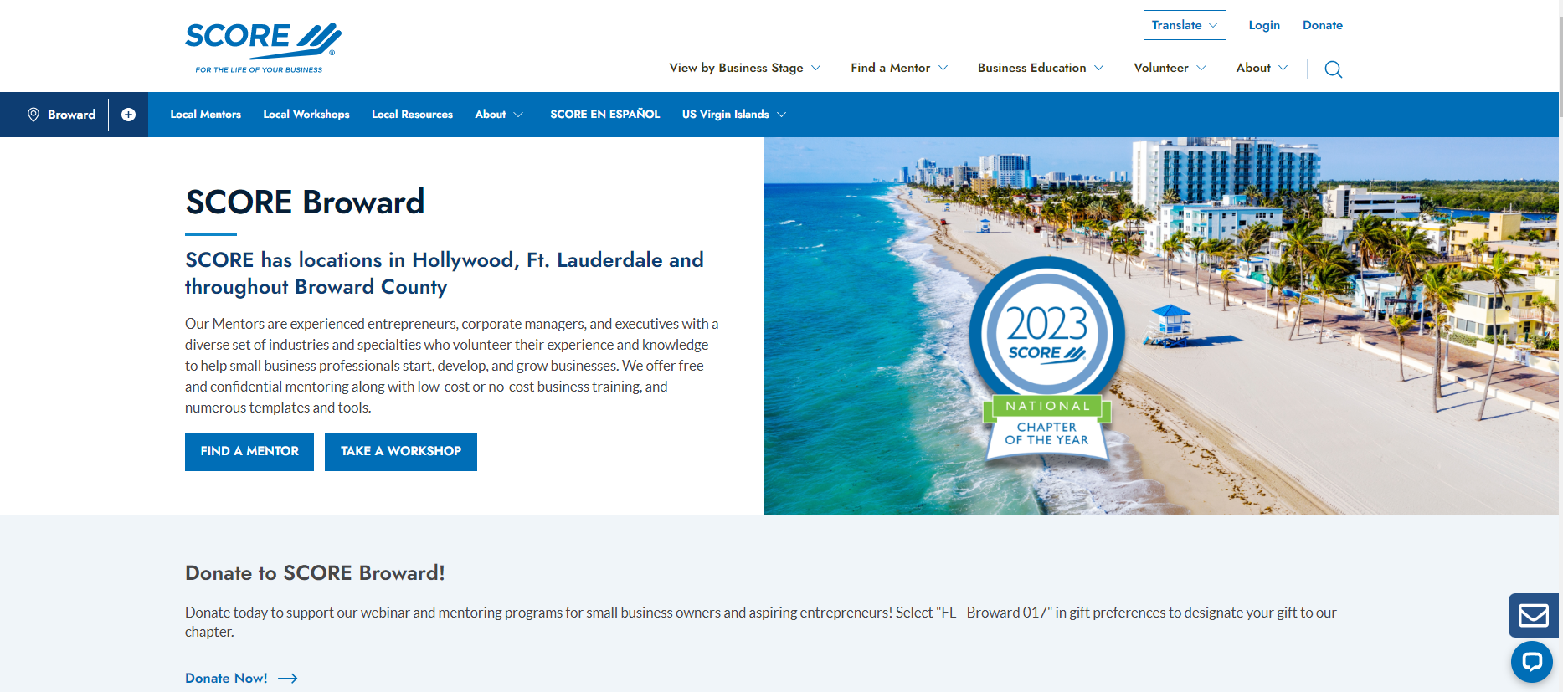
Next steps
Continue your search for knowledge through other SCORE’s workshops/webinars and mentoring/counseling services: www.broward.score.org

